Slide 1

News-ish
A Machine Learning Classification Model
by Matt Mead, Allan Hunt, Alex Mogren, and Emilio Bello

Slide 2

Project Description
This project is a machine learning exercise in which we used an NLP classification model to determine whether a news article is considered a reliable source of information. The model implements a Multinomial Naïve Bayes algorithm to predict these news sources as “reliable” or “unreliable”.
The process started by exploring the data, preprocessing the model input, training the model and testing it. Finally, we developed a website that features a user input form on our home page in which you can paste your own article to determine whether it is a reliable information source.

Slide 3
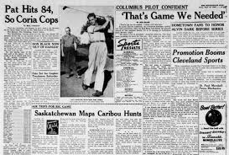
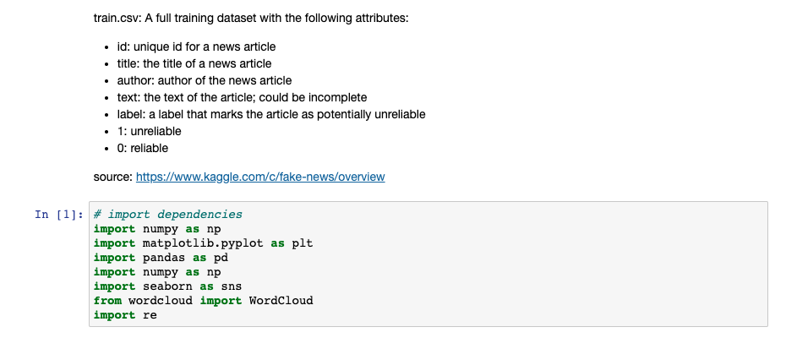
Data Exploration

Slide 4
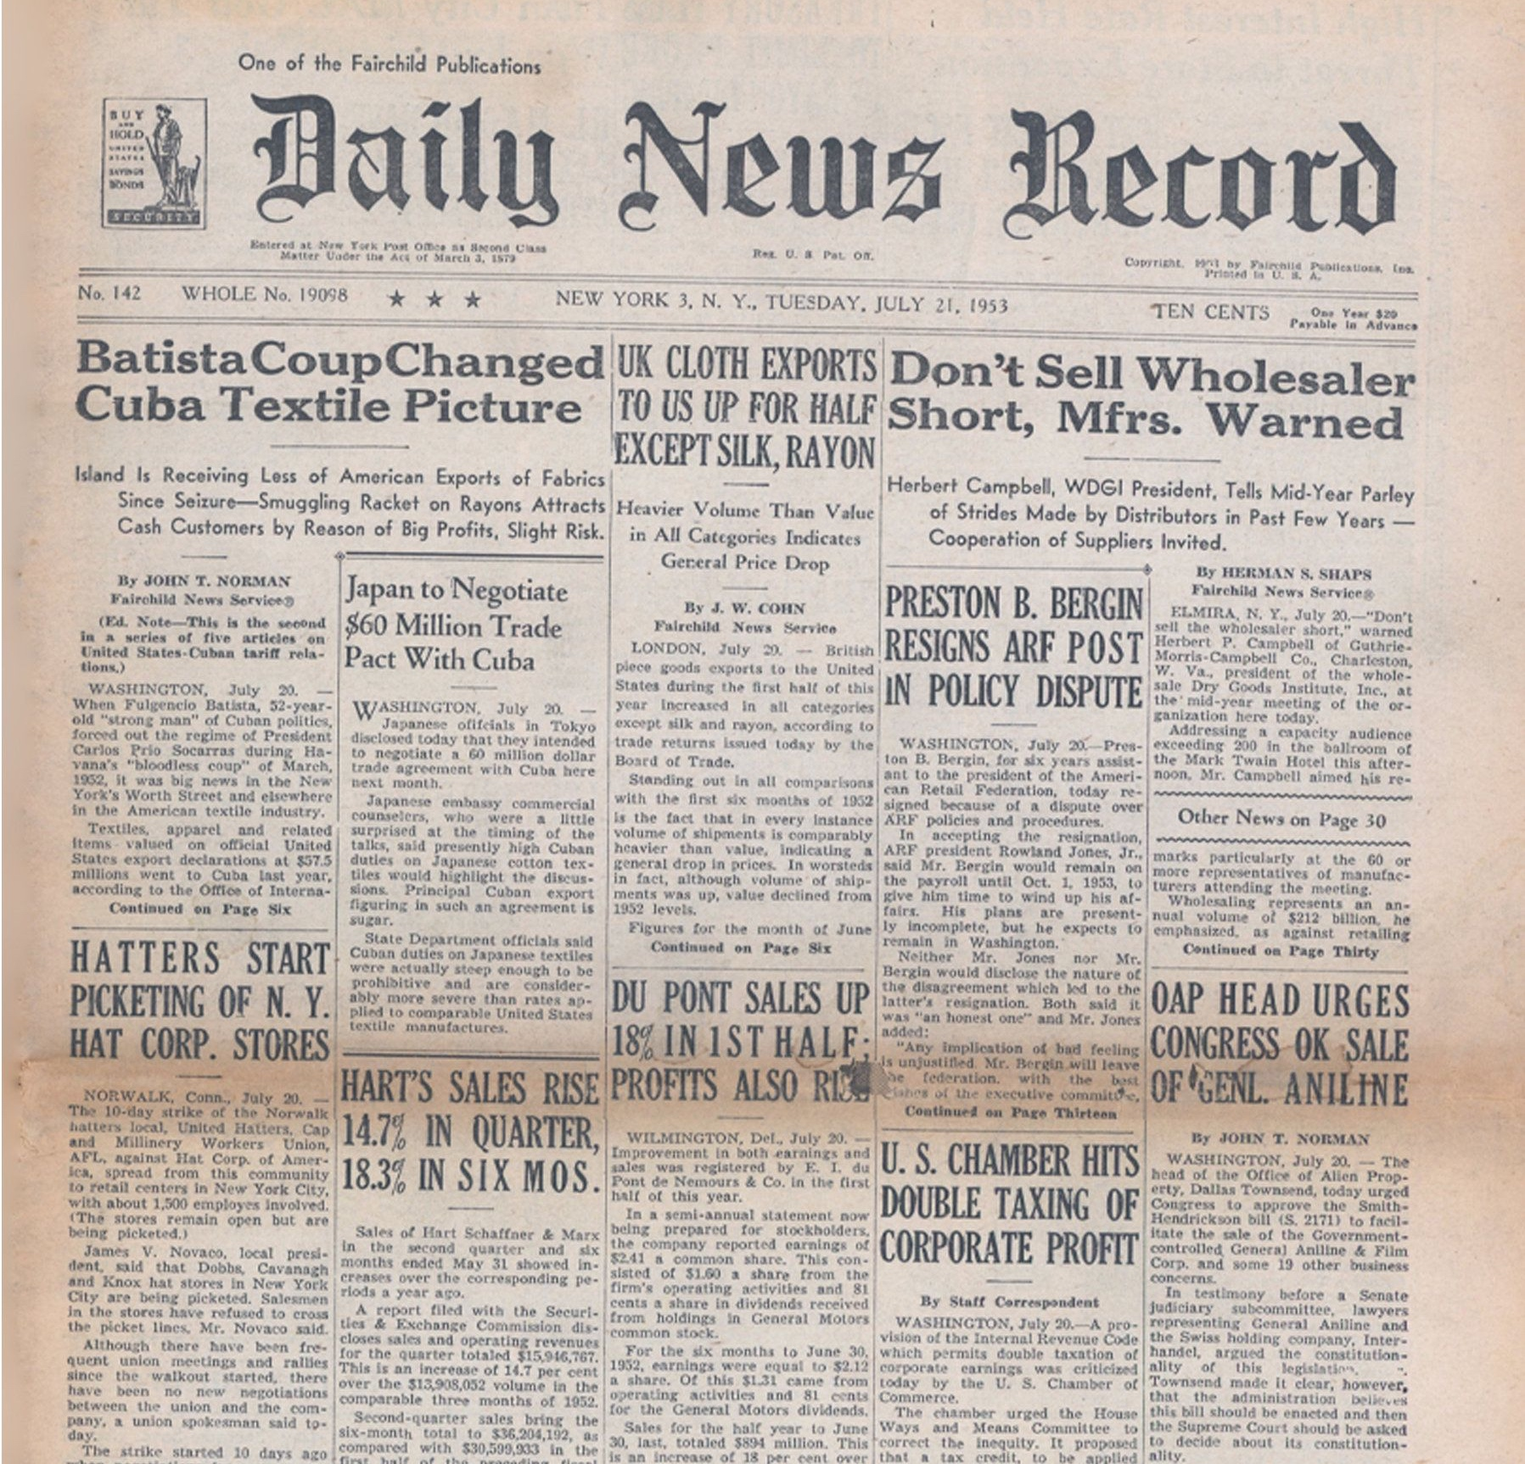

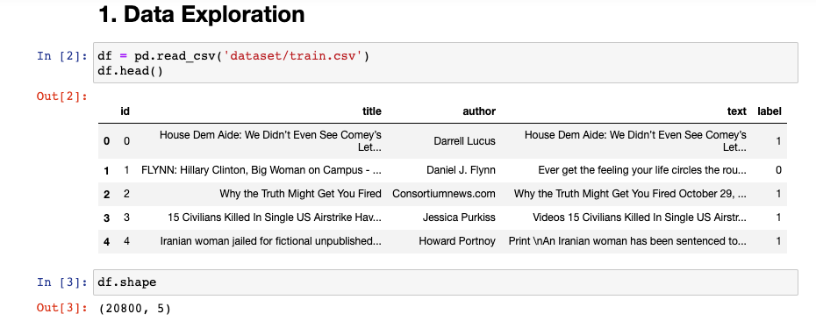
Data Exploration

Slide 5

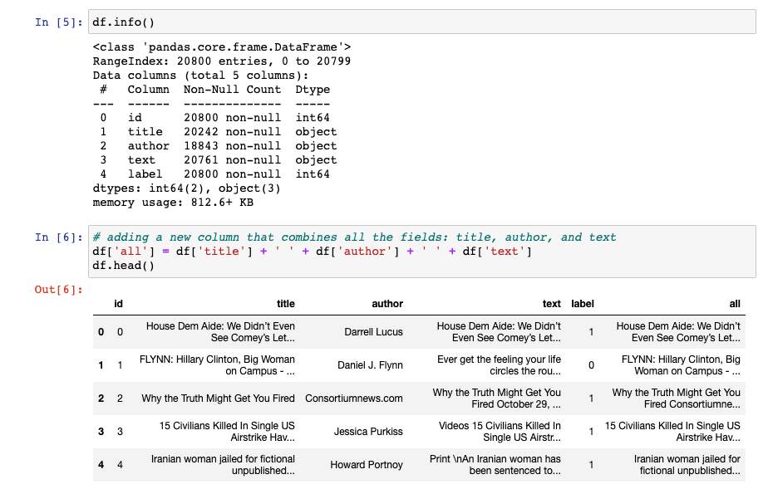
Data Exploration

Slide 6
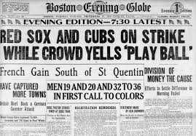
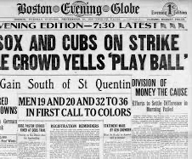
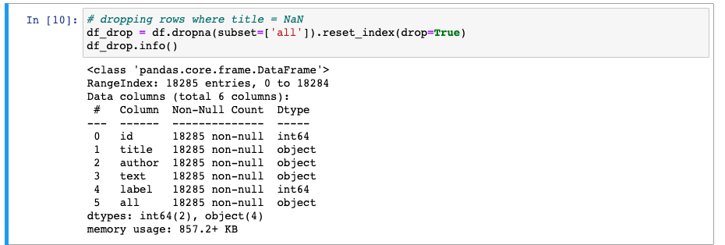
Data Exploration

Slide 7


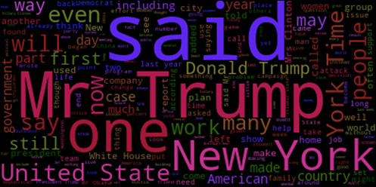
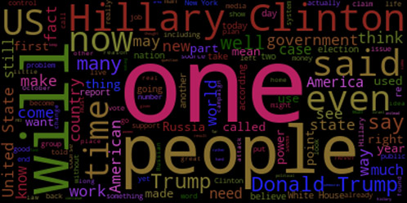
Data Exploration
Unreliable

Slide 8


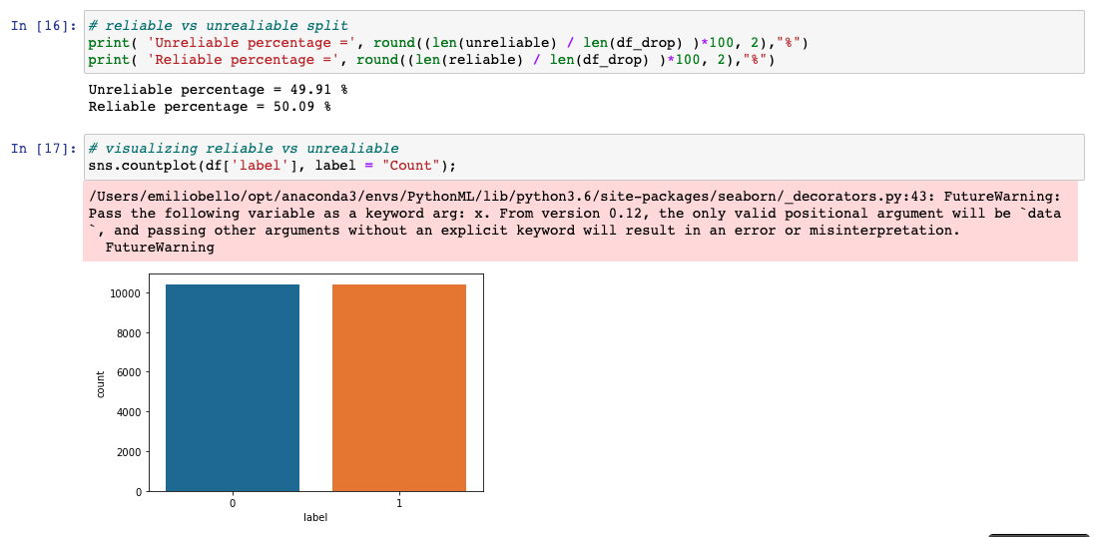
Data Exploration

Slide 9

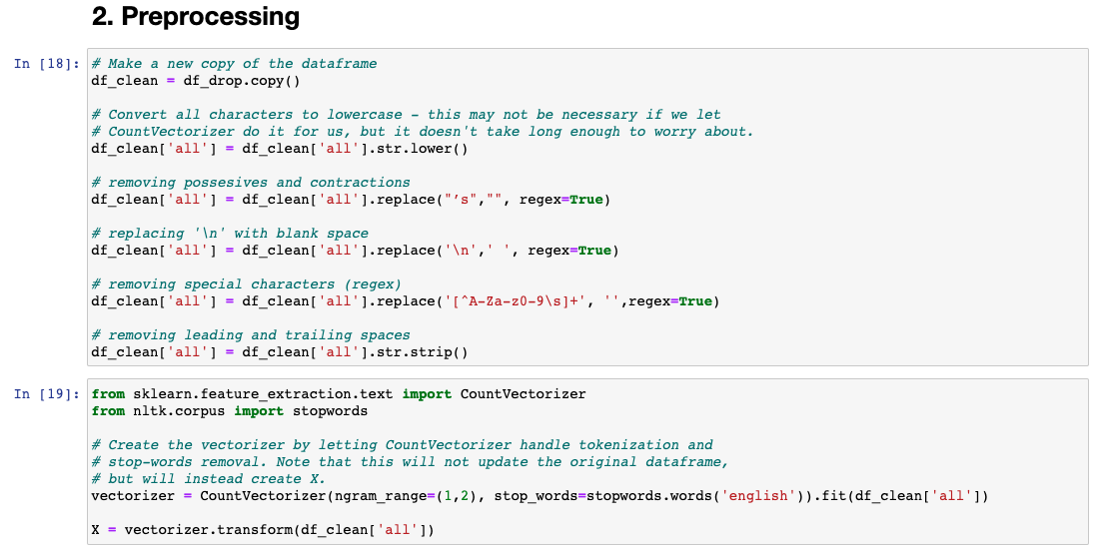
Preprocessing

Slide 10


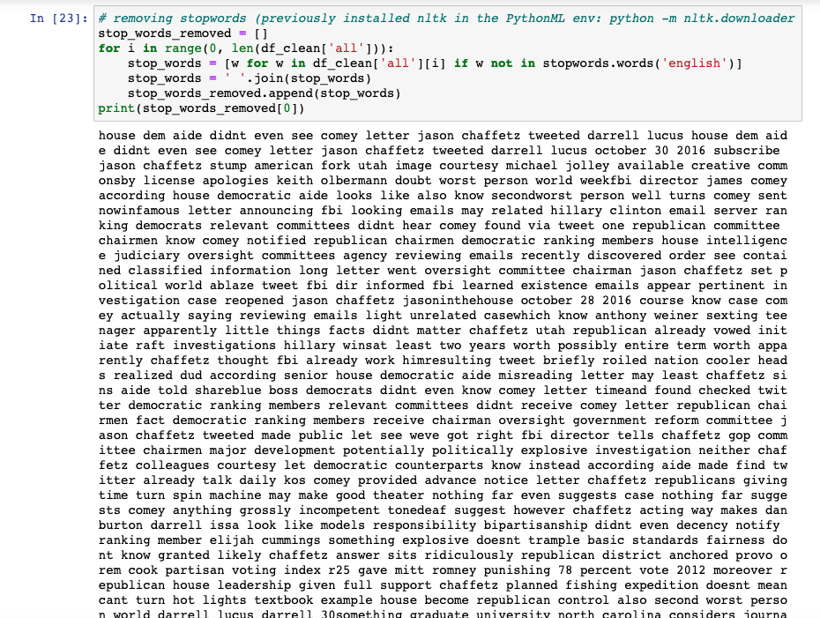
Preprocessing

Slide 11
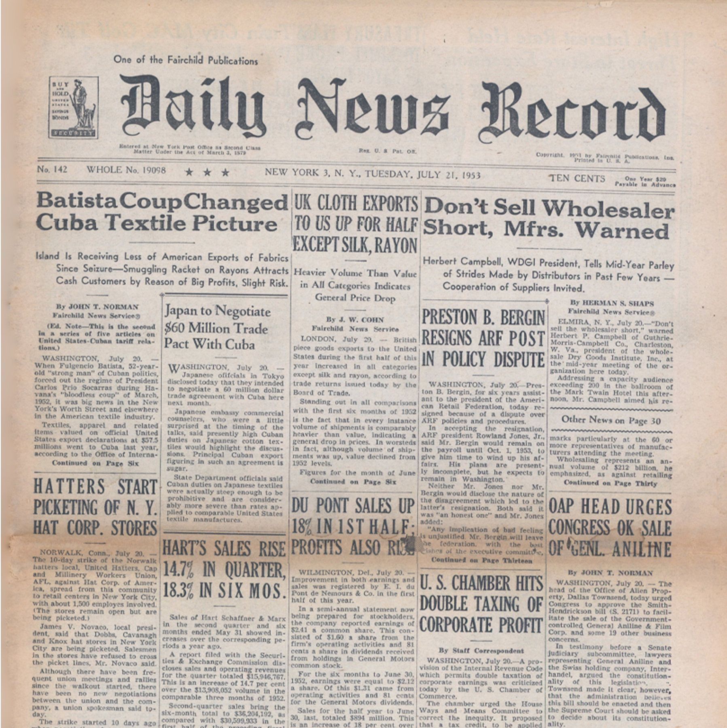
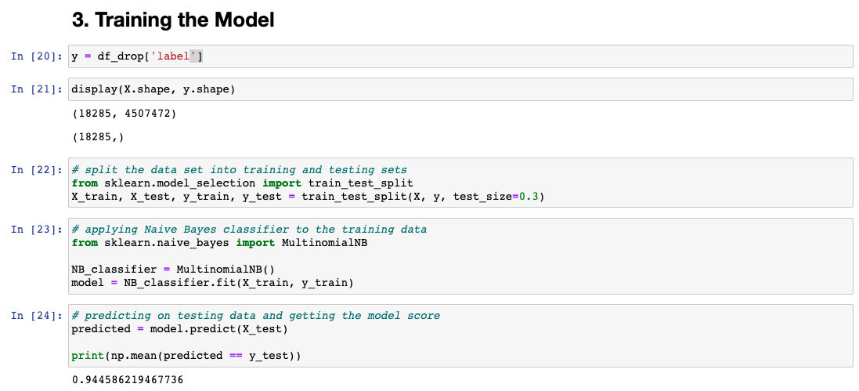
Training the Model

Slide 12
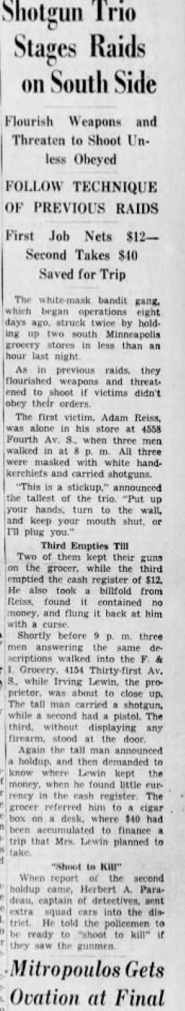
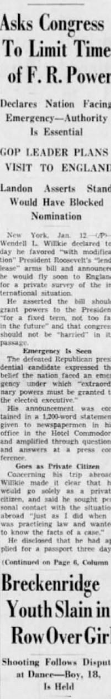

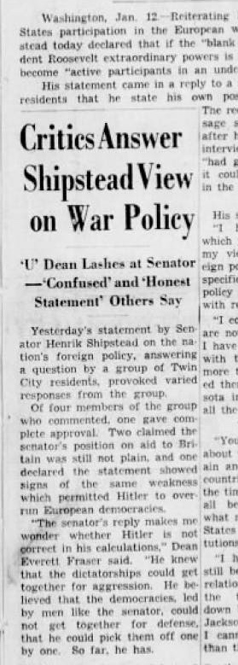

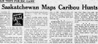
Naïve Bayes Classifier
Naive bayes combines both probability & bayes theorem to predict the outcome of a text, then categorizes it to a tag word.
In simpler terms, tag words are like "categories", we are trying to decipher snippets of text to be put into these categories.
A good example of naive bayes is a primary email box versus a spam email box. Our best outcome was the combination of 3 fields: title, author, and text.

